Slide 1
Thank you for joining us today for this presentation.

Slide 2
The fundamental goal of a Socially Conscious Community is to create best outcomes for all animals. The responsibilities of Socially Conscious Shelters include:
Ensuring every unwanted or homeless pet has a safe place to go for shelter and care
Notes:
Every pet should have a shelter that will accept 24 hours per day, 7 days per week, without exception
Often strays are found and need a place to go, or a family is in crisis and needs to find a safe place for the pet immediately
Most communities have shelters that accept every animal and shelters that accept only selected animals on a limited basis. These groups can work together well if they are respectful and transparent.

Slide 4
The fundamental goal of a Socially Conscious Community is to create best outcomes for all animals. The responsibilities of Socially Conscious Shelters include:
Placing every healthy and safe animal
Notes:
CELEBRATION!!! This is the coolest part of the entire commitment—that every Socially Conscious Shelter is placing every healthy and safe animal
Euthanasia decisions are never based on how long a pet has been at the shelter or the number of kennels available
Healthy – includes pets that are completely healthy and pets that have a good or excellent prognosis to become healthy
Safe – has not displayed behavior that is likely to cause significant bodily harm or death to any person or other animal

Slide 6
The fundamental goal of a Socially Conscious Community is to create best outcomes for all animals. The responsibilities of Socially Conscious Shelters include:
Assessing the medical and behavioral needs of homeless animals and ensuring these needs are thoughtfully addressed
Notes:
Ensuring pets within the shelter are receiving timely and appropriate veterinary care
The mental needs of animals housed in a shelter must be understood. Enrichment should be provided, including toys, exercise, space, elevated perching areas, hiding places
Socially Conscious Shelters to not allow animals to become “shut down” or to exhibit extreme signs of anxiety such as incessant circling
When a shelter does not have the resources to provide appropriate emotional support for the pet, the animal should be transferred to a facility that does as long as the animal is healthy and safe

Slide 8
The fundamental goal of a Socially Conscious Community is to create best outcomes for all animals. The responsibilities of Socially Conscious Shelters include:
Alleviating suffering and making appropriate euthanasia decisions
Notes:
Each decision is made with all available information regarding that animal, both historically and through individual evaluation
If an animal suffers from a disease or injury that cannot be addressed with reasonable intervention, then euthanasia may be appropriate
These are very similar to the decisions made by pet owners for their beloved pets at the end of the pet’s life
It is the responsibility of a socially conscious shelter to ensure that dangerous animals are not placed in our community

Slide 9
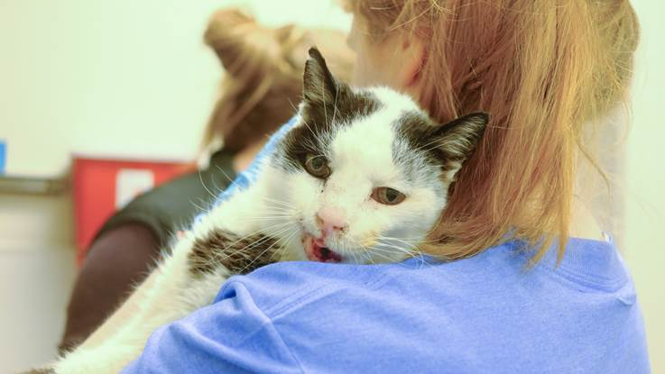

Slide 10
The fundamental goal of a Socially Conscious Community is to create best outcomes for all animals. The responsibilities of Socially Conscious Shelters include:
Aligning policy with the needs of the community
Notes:
Communicating directly and intentionally with member of the community
Determine what behavior and medical challenges adopters are willing to assume
Listening—the socially conscious shelter is an integral part of the community
Fluid—every year these conversations change. Keep interacting.

Slide 12
The fundamental goal of a Socially Conscious Community is to create best outcomes for all animals. The responsibilities of Socially Conscious Shelters include:
Enhancing the human-animal bond through thoughtful placements and post- adoption support
Notes:
Understand the lifestyle of the adopter and the needs and traits of the pet to make the best match possible
Variable levels of screening before adoption—different methods are successful in different situations. When adopting special needs or fearful dogs, more screening might be needed. However, when adopting healthy and safe dogs and cats, come from a place of trust and conversation.
Supporting new owners and pets after adoption
Levels of support vary, some shelters can treat medical conditions and others can only accept the animal back. In no circumstance should a new adopter be stuck with a sick or dangerous animal.

Slide 14
The fundamental goal of a Socially Conscious Community is to create best outcomes for all animals. The responsibilities of Socially Conscious Shelters include:
Considering the health and wellness of each animal and each community when transferring animals between communities
Notes:
Ensuring source communities are supported to work toward solving pet overpopulation and lack of understanding about care of pets
Reducing, managing and disclosing risks for animals and people in the community that receives the animals. Understand any infectious disease risks that might be brought into a new geographical area and proactively manage these risks. (Heartworm disease is a good example).

Slide 16
The fundamental goal of a Socially Conscious Community is to create best outcomes for all animals. The responsibilities of Socially Conscious Shelters include:
Fostering a culture of transparency, ethical decision making, mutual respect, continual learning and collaboration
Notes:
Socially conscious shelters freely disclose information about their operations, statistics, philosophy, successes and mistakes
Integrity drives all decisions
Animal welfare is constantly evolving—SCS’s work towards understanding how to best care for shelter pets and at-risk community pets
Understand we are all working towards the same goal and work towards one another’s success at creating best outcomes for all animals

