Slide 1
Socially Conscious Animal Communities &
Socially Conscious Sheltering

Slide 2
Socially Conscious Animal Community

Slide 3
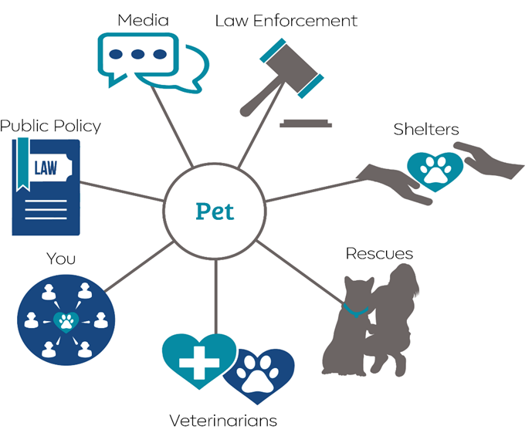
Socially Conscious
Animal Community
Notes:
Every pet should have a shelter that will accept 24 hours per day, 7 days per week, without exception
Often strays are found and need a place to go, or a family is in crisis and needs to find a safe place for the pet immediately
Most communities have shelters that accept every animal and shelters that accept only selected animals on a limited basis. These groups can work together well if they are respectful and transparent.

Slide 4
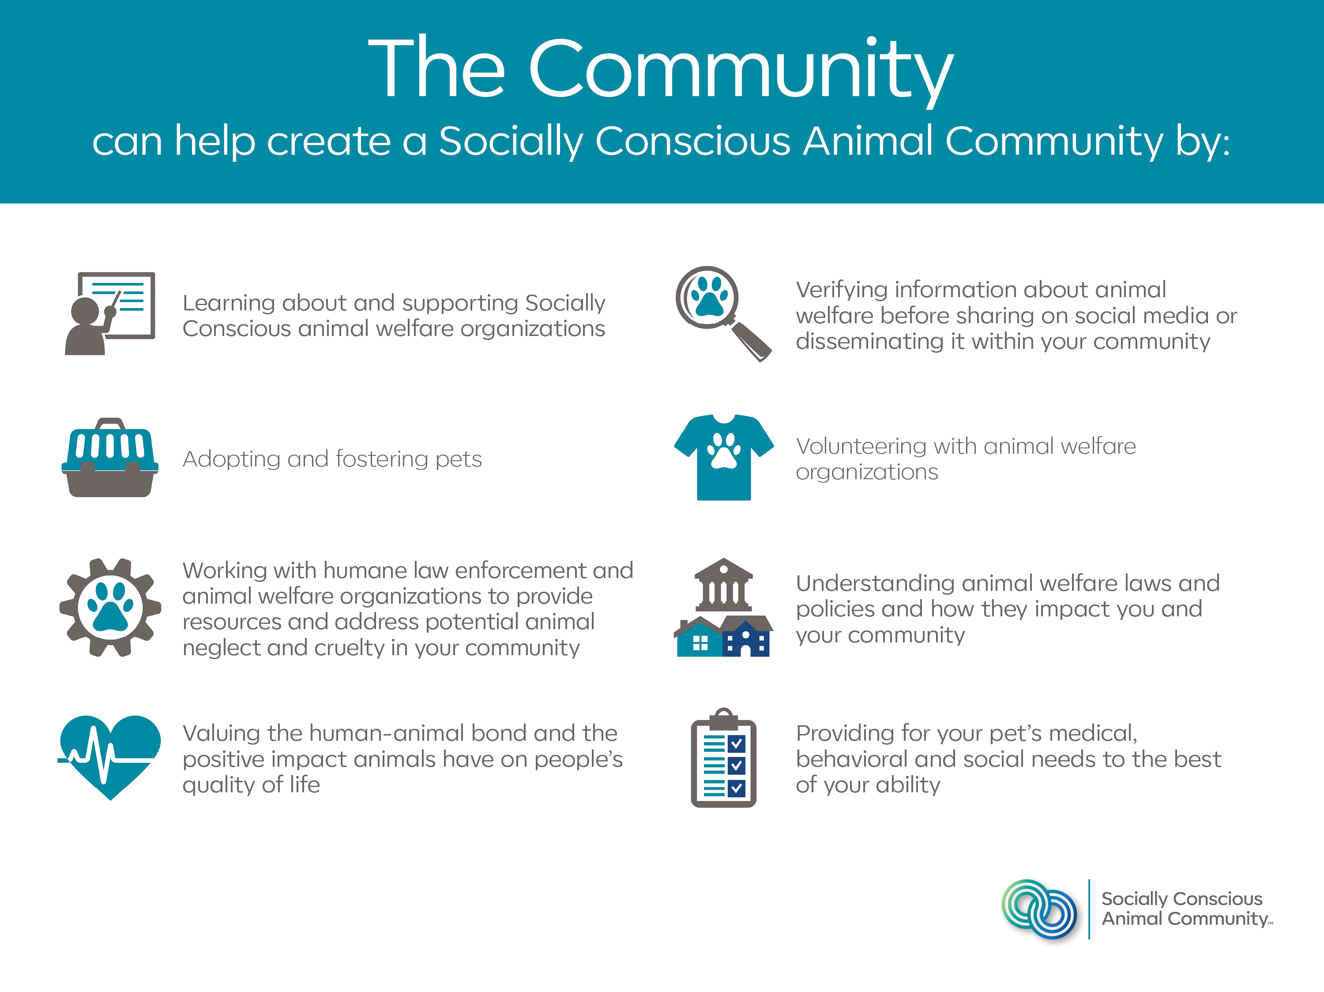

Slide 5
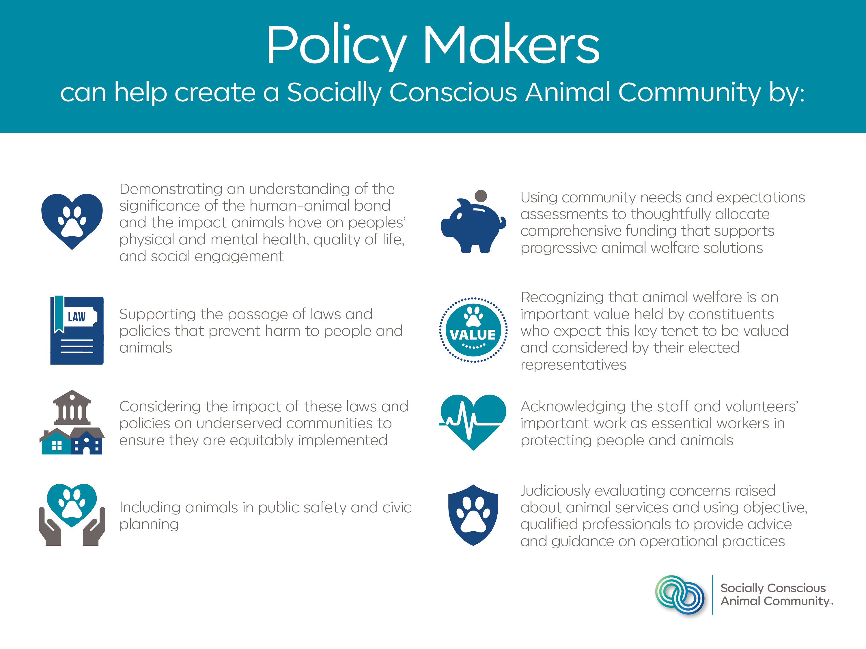

Slide 6
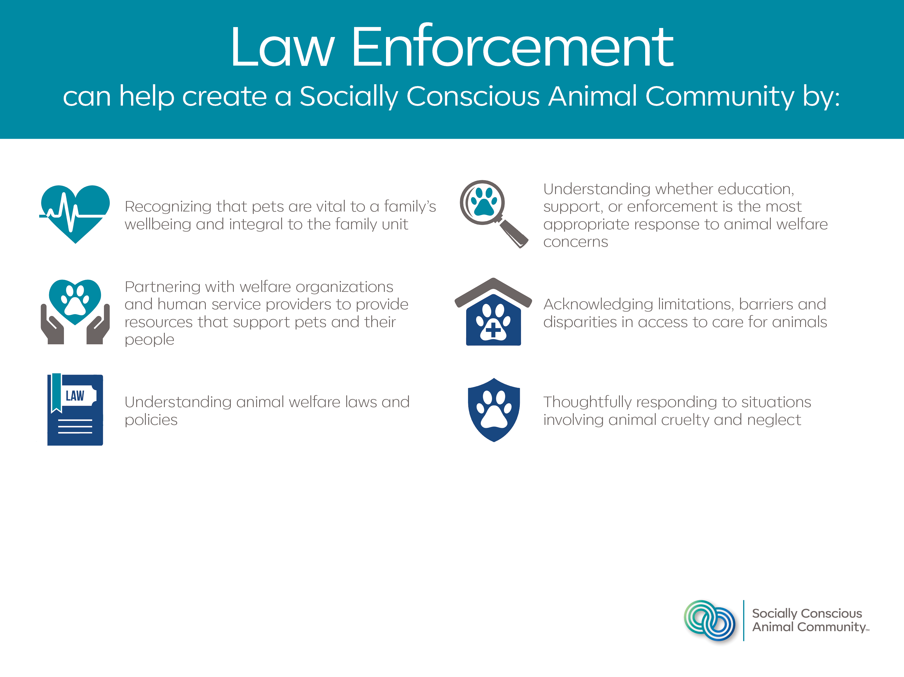

Slide 10
Socially Conscious Sheltering

Slide 11
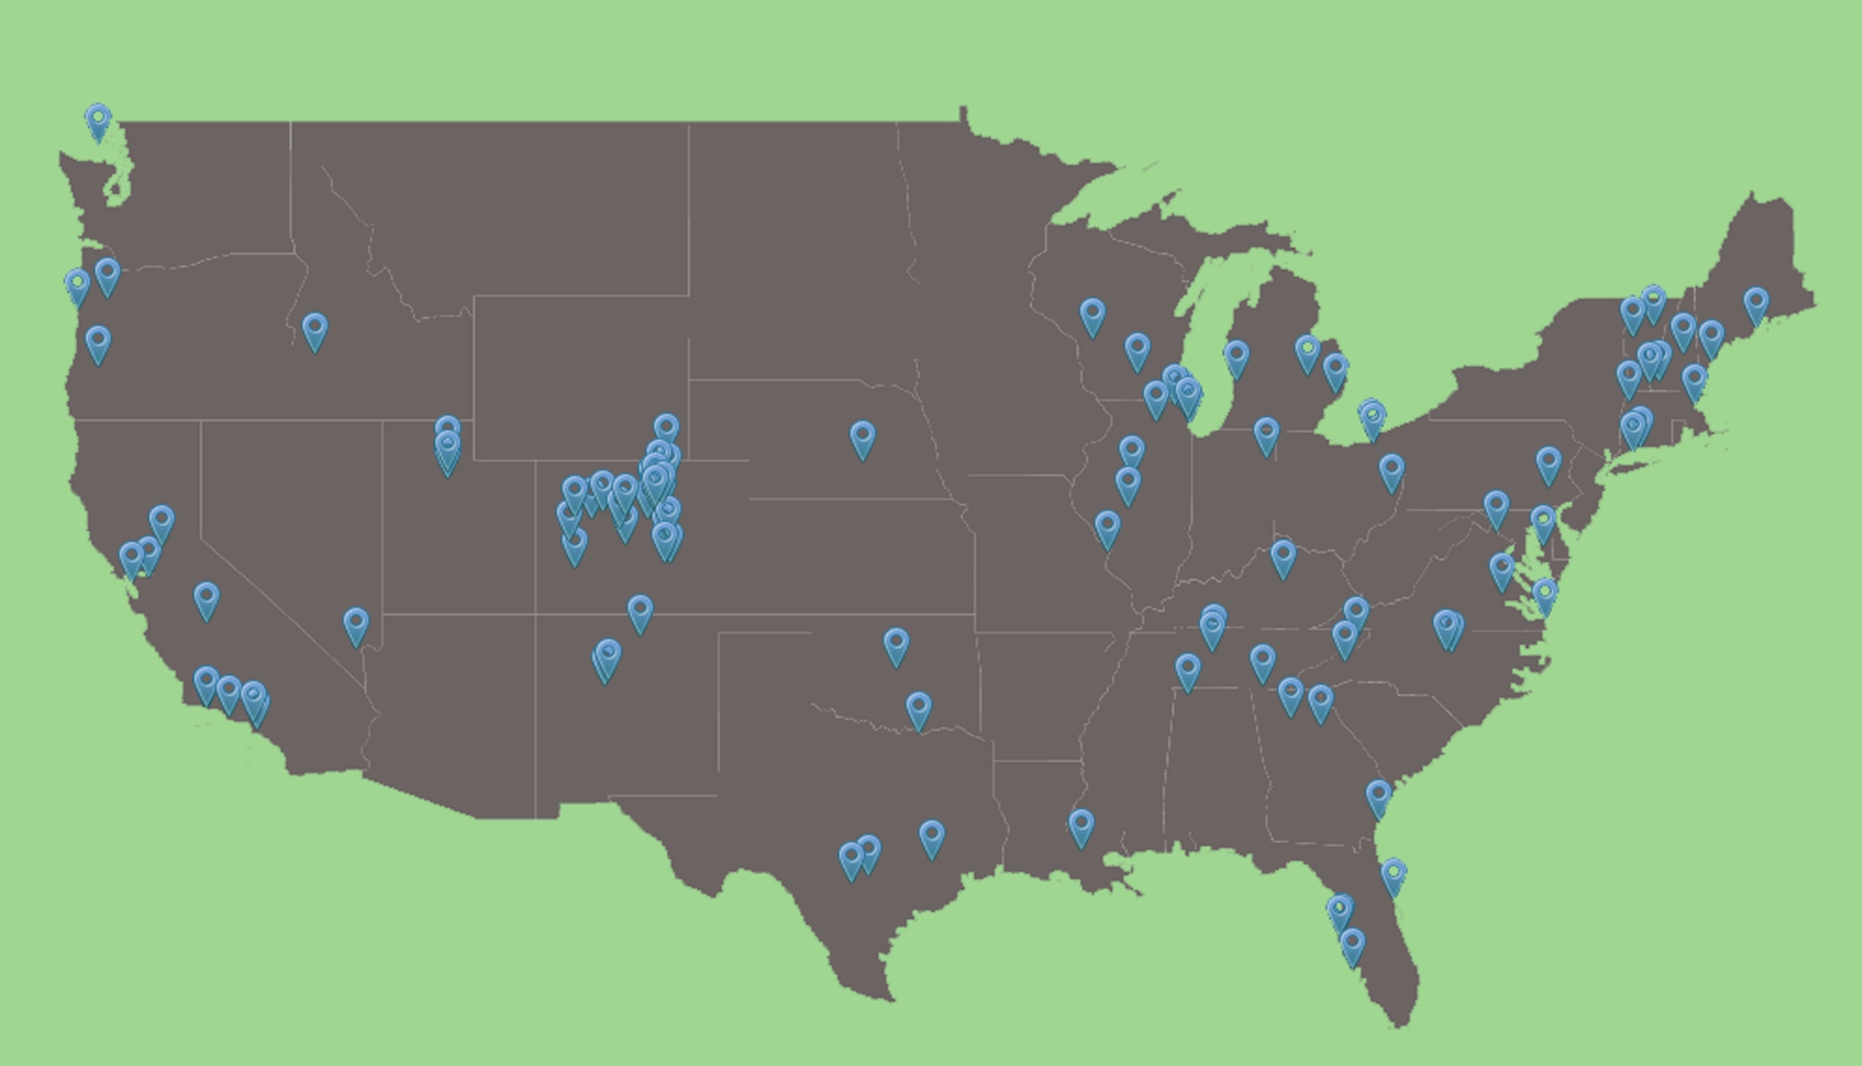
Socially Conscious Sheltering has been adopted by shelters and rescues across the country

Slide 12
Ensuring every unwanted or homeless pet has a safe place to go for shelter and care

Slide 13
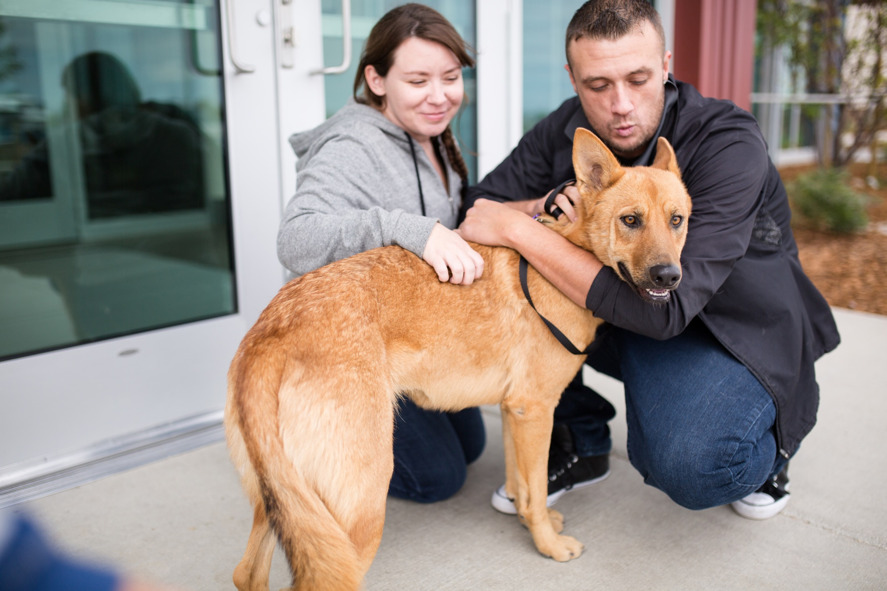
Place (at least) every healthy and safe animal

Slide 14
Healthy & Safe
Healthy = no signs of clinical disease or, if there is evidence of disease, there is a reasonable expectation for a good quality of life
Safe = has not exhibited behavior that is likely to result in bodily injury or death to another animal or person
Notes:
CELEBRATION!!! This is the coolest part of the entire commitment—that every Socially Conscious Shelter is placing every healthy and safe animal
Euthanasia decisions are never based on how long a pet has been at the shelter or the number of kennels available
Healthy – includes pets that are completely healthy and pets that have a good or excellent prognosis to become healthy
Safe – has not displayed behavior that is likely to cause significant bodily harm or death to any person or other animal

Slide 15
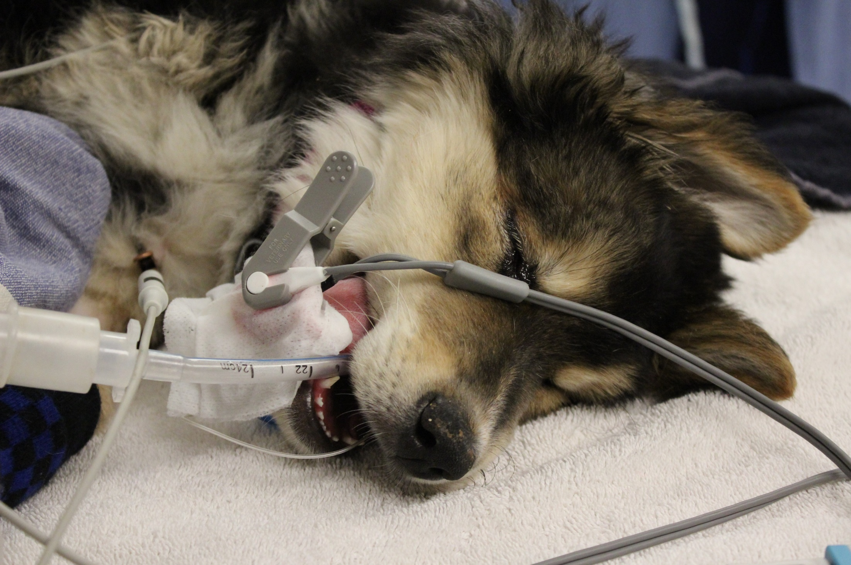
Assessing the medical and behavioral needs of homeless animals and ensuring these needs are thoughtfully addressed

Slide 16
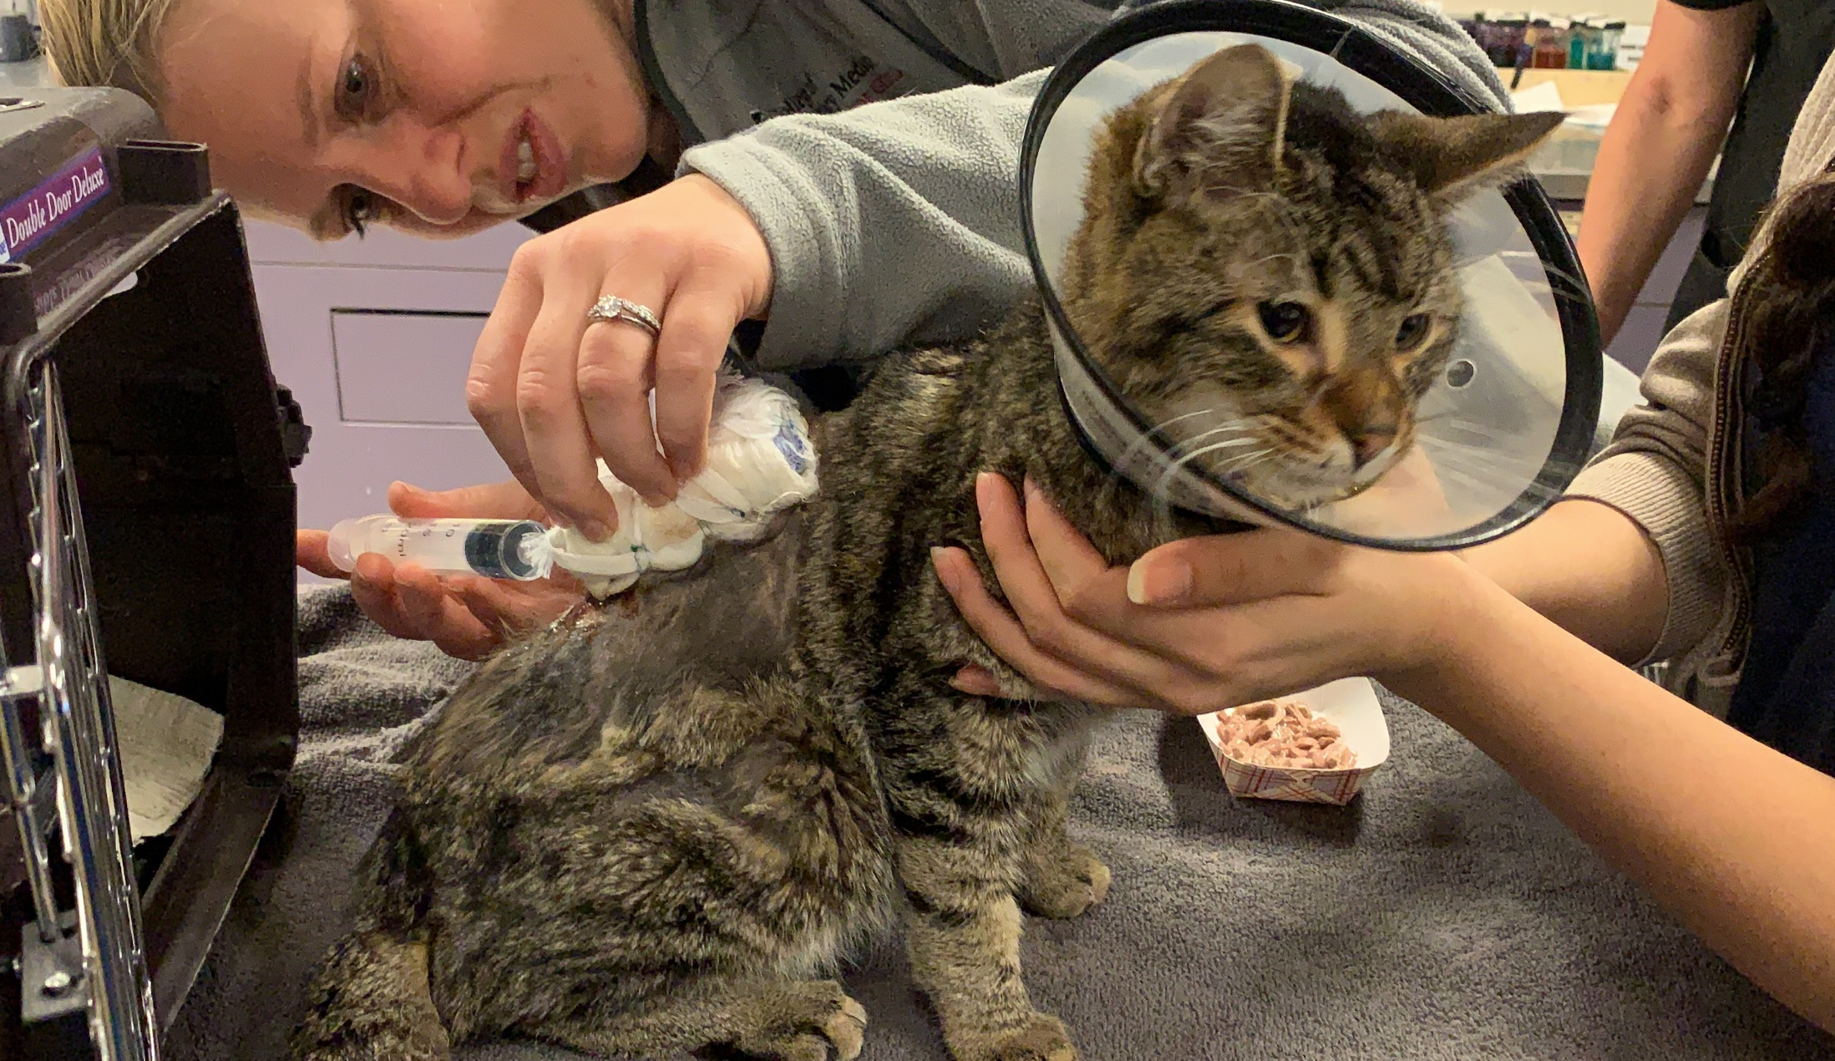
Alleviating suffering and making appropriate euthanasia decisions

Slide 17
Aligning policy with the needs of the community

Slide 18
Enhancing the human-animal bond through thoughtful placements and post-adoption support

Slide 19
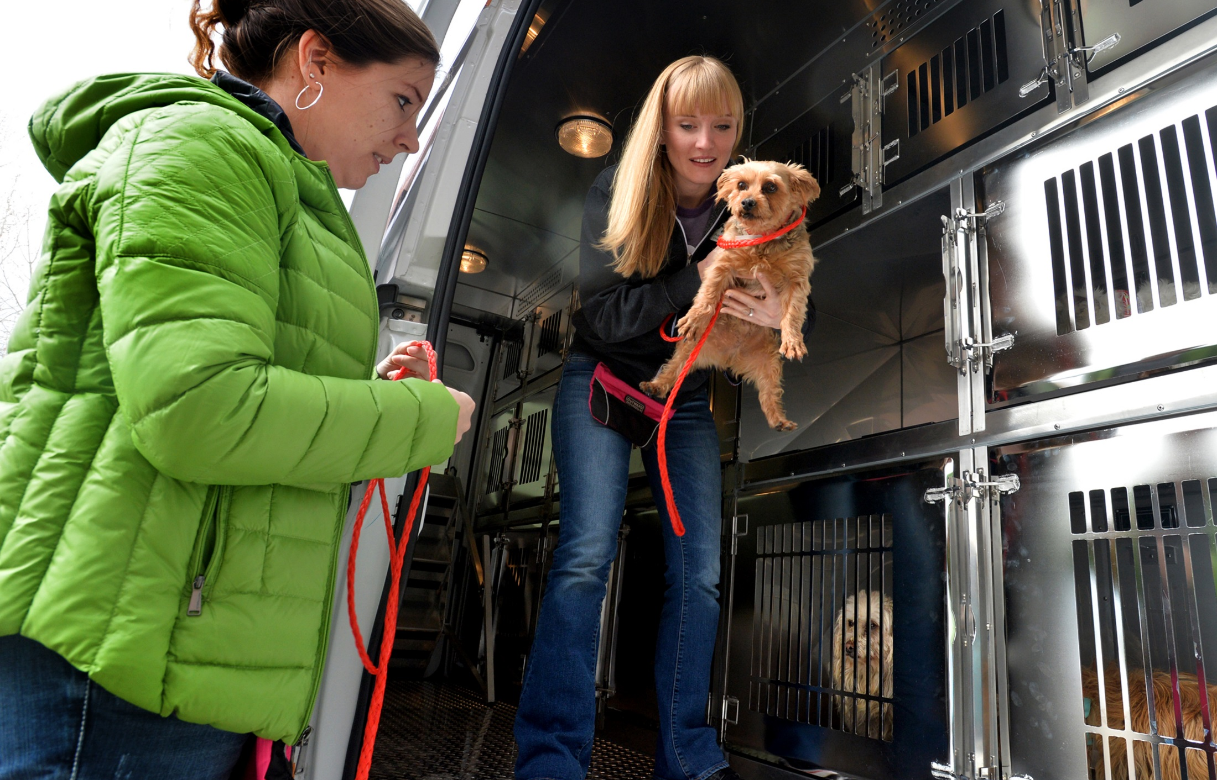
Considering the health and wellness of each animal and each community when transferring animals between communities

Slide 20
Implementing inclusive policies and practices

Slide 21
Fostering a culture of transparency, ethical decision making, mutual respect, continual learning, and collaboration

Slide 22
Questions?
Anna Jaeger: ajaeger@ddfl.org
Ali Mickelson: amickelson@ddfl.org

